Slide 1
Code Control Statements
In Python

Slide 2
Objectives
Understand how Boolean (true/false) expressions are evaluated
Code, test, and debug programs that require skills in using the following programming constructs in Python:
if statements
while statements
for statements

Slide 3
Boolean Expressions
Boolean expressions are expressions that will evaluate to either True (1) or False (0).
A combination of relational operators and logical operators can be used to evaluate Boolean expressions.

Slide 4
Relational Operators
Logical Operators
Order of Precedence:
NOT
AND
OR

Slide 5
Relational Operators (examples)

Slide 6
Logical Operators (examples)

Slide 7
String Comparisons in Boolean Expressions
Strings are evaluated 1 character at a time, moving left-to-right, according to sort sequence of digits and letters.
Sort sequence of digits and letters:
Digits from 0-9
Uppercase letters from A-Z
Lowercase letters from a-z

Slide 8
The if statement
The syntax of the if statement
Depending on the logic or one or more conditions, multiple paths of action may be taken by your program.

Slide 9
The if statement
An if statement always contains an if clause. In addition, it can optionally contain one or more elif clauses and one else clause.
When an if statement is executed, the if clause is evaluated first. If it is true, the statements in this clause are executed and the if statement ends. Otherwise, the first elif (else if) clause is evaluated.
If the statement in the first elif clause is true, the statements in this clause are executed. Otherwise, the next elif clause is evaluated. This continues until the condition in one of the elif clauses is true or the else clause is reached.
The statements in the else clause are executed if the conditions in all of the preceding clauses are false.
Only one block of statements can be run for each time an if statement is executed.

Slide 10
The if statement (examples)
Only an if clause

Slide 11
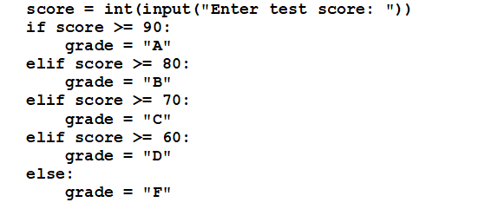
The if statement (examples)
An if statement used for grading

Slide 12
The while statement
The syntax of the while statement
A series of actions will continue to be performed in a looping fashion until some predefined condition becomes False.

Slide 13
The while statement
In a while statement, Python begins by testing the condition defined by the Boolean expression at the top of the statement. Then, if this condition is True, Python executes the statements in the while loop until the condition is False.
If the condition initially evaluates to False, Python never executes the code in the loop.
If the condition never evaluates to False, the loop never ends. This is an logic error known as an infinite loop.
A while loop uses a Boolean condition to determine the number of times it executes.

Slide 14
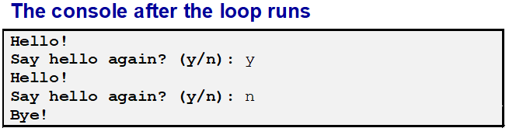
The while statement (examples)
# A while loop that continues as long as
# The user enters "y" or "Y“
choice = "y"
while (choice = "y") or (choice == "Y"):
print("Hello! ")
choice = input("Say hello again? (y/n): ")
print("Bye!") # runs when loop ends

Slide 15
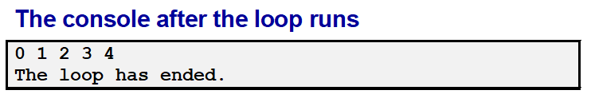
The while statement (examples)
# A while loop that prints the numbers
# 0 to 4 to the console
counter = 0
while counter < 5:
print(counter)
counter = counter + 1
print("The loop has ended.") # runs when loop ends

Slide 16
The for statement
The syntax of the for statement
A series of actions will continue to be performed in a looping fashion until some predefined number of loops are completed.

Slide 17
The for statement
When you use the for statement, it executes a for loop once for each integer in a predefined collection of integers.
Each time through the loop, the integer variable at the top of the loop receives the next integer in the collection. The loop ends after it executes for the last integer in the collection.
The predefined collection of integers is called the range.

Slide 18
Using the range() function with for loops
Note: the for loop is NOT entered for the “stop” number of the range. When the for loop hits the “stop” number, then the for loop is no longer executed.

Slide 19
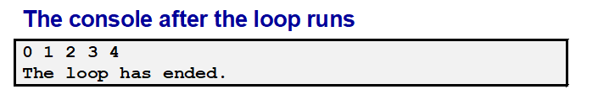
The for statement (examples)
# A for loop that prints the numbers 0 to 4
for counter in range(5):
print(counter)
print("The loop has ended.") # runs when loop ends

Slide 20

The for statement (examples)
# A for loop that sums the numbers 1 to 4
sum_of_numbers = 0
for counter in range(1,5):
sum_of_numbers = sum_of_numbers + counter
print(sum_of_numbers) # runs when loop ends
Loop Iteration | Starting sum_of_numbers | counter | Ending sum_of_numbers
1 | 0 | 1 | 0+1 = 1
2 | 1 | 2 | 1+2 = 3
3 | 3 | 3 | 3+3 = 6
4 | 6 | 4 | 6 + 4 = 10
Exit |  | 5

